Slide 1
Pham Van Minh
BH01037

Slide 2
agenda
INTRODUCTION 3
BUILDING CONFIDENCE 4
ENGAGING THE AUDIENCE 5
VISUAL AIDS 6
FINAL TIPS & TAKEAWAYS 11

Slide 3

Introduction

Slide 4
The Building Blocks of Computer Science
Data structures and algorithms are fundamental to computer science.
They provide efficient ways to organize, store, and process data.
Understanding them is crucial for developing efficient and optimized software.

Slide 5

Design Specification for Data Structures

Slide 6
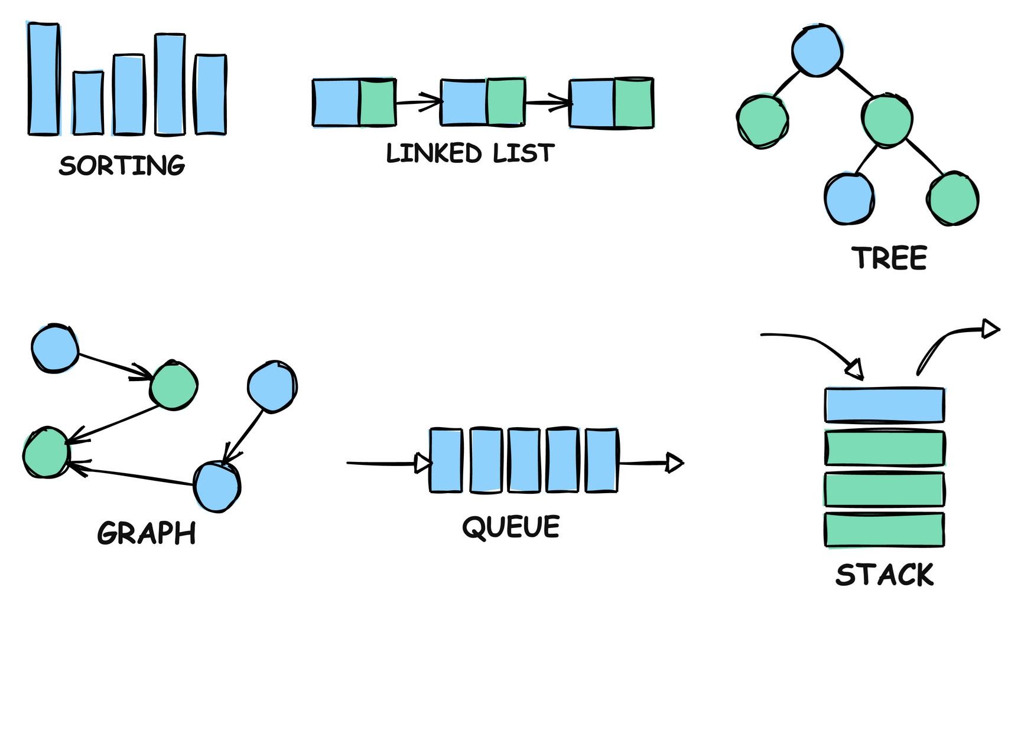
What are Data Structures?
Identifying Data Structures
A data structure is a specialized format for organizing, processing, retrieving, and storing data in a computer.
Common Types:
Arrays
Linked Lists
StacksQueues
Trees
Graphs

Slide 7
Operations on Data Structures
Defining Operations
Each data structure supports specific operations.
Examples:
Arrays: Insertion, deletion, searching, sorting.
Linked Lists: Insertion, deletion, traversal.
Stacks: Push, pop, peek.
Queues: Enqueue, dequeue.

Slide 8
Specifying Input Parameters
Input Parameters
Clearly define the type and range of input values for each operation.
Example: For an "insert" operation in an array:
value: The data element to be inserted (e.g., integer, string).
index: The position where the element should be inserted (integer, within the array bounds).

Slide 9
Ensuring Correctness
Pre- and Post-conditions
Pre-conditions: Conditions that must be true before an operation can be executed.
Post-conditions: Conditions that will be true after the operation is successfully completed.
Example: For a "pop" operation on a stack:
Pre-condition: The stack must not be empty.
Post-condition: The top element is removed, and the size of the stack is reduced by one.

Slide 10
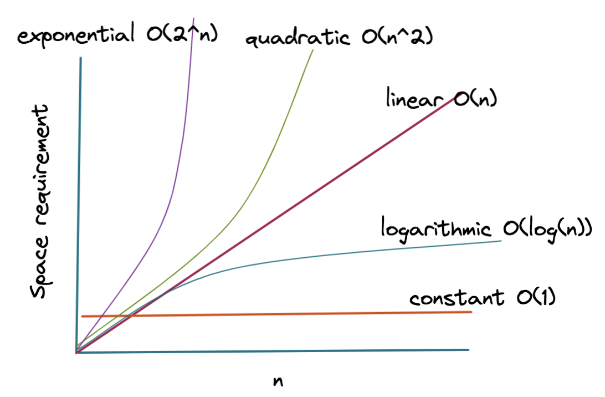
Efficiency Matters
Time and Space Complexity
Time Complexity: How the runtime of an operation grows with the input size (e.g., O(n), O(log n)).
Space Complexity: How much memory an operation requires (e.g., O(1), O(n)).

Slide 11
Putting it into Practice
Examples and Code Snippets
Time Complexity: How the runtime of an operation grows with the input size (e.g., O(n), O(log n)).
Space Complexity: How much memory an operation requires (e.g., O(1), O(n)).

Slide 12
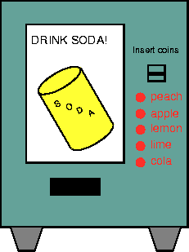
Abstract Data Types: Hiding the Details
What is an Abstract Data Type (ADT)?
An ADT is a high-level description of a data structure that focuses on what it does, not how it does it.
It defines a set of operations that can be performed on the data, without specifying the underlying implementation.

Slide 13
Stack and Queue

Slide 14
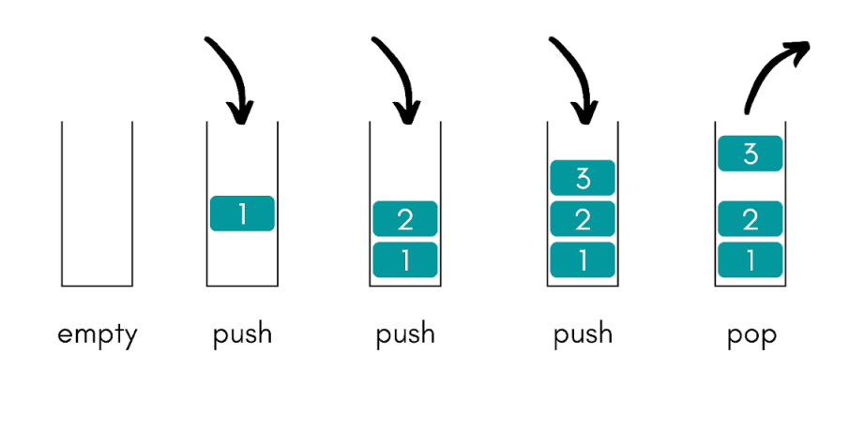
The LIFO Data Structure
Stack ADT
A stack follows the Last-In, First-Out (LIFO) principle. Imagine a stack of plates; you can only add or remove plates from the top.
It defines a set of operations that can be performed on the data, without specifying the underlying implementation.
Operations:
push(item): Adds an item to the top of the stack.
pop(): Removes and returns the item from the top.
peek(): Returns the top item without removing it.

Slide 15
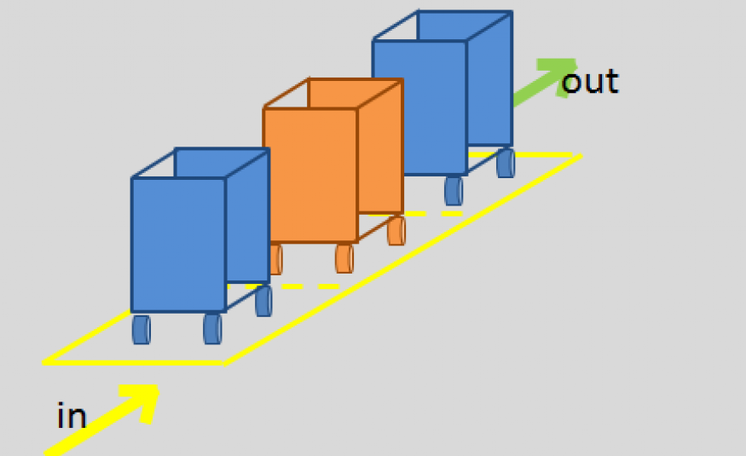
First-In, First-Out
Queue ADT
Definition: A queue where elements are added at the rear and removed from the front.
Analogy: A line of people waiting for a service.

Slide 16
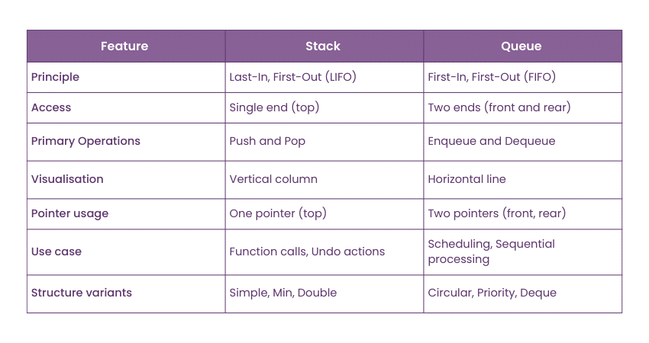
Comparing Stack and Queue
Stack vs. Queue

Slide 17
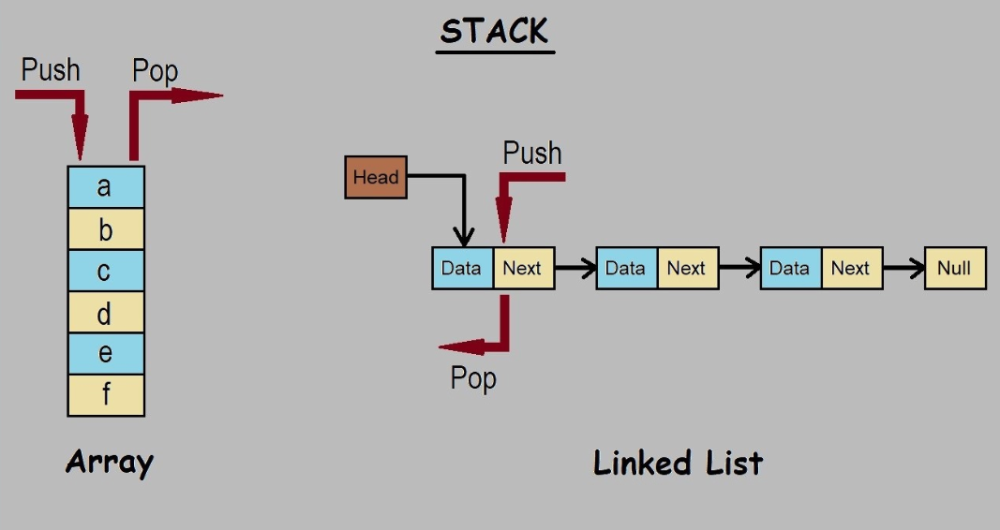
Implementation Choices
Implementing Stack and Queue
Both stacks and queues can be implemented using:
Arrays: A fixed-size, contiguous block of memory.
Linked Lists: A dynamic data structure where elements are linked together using pointers.

Slide 18
Sorting algorithms

Slide 19
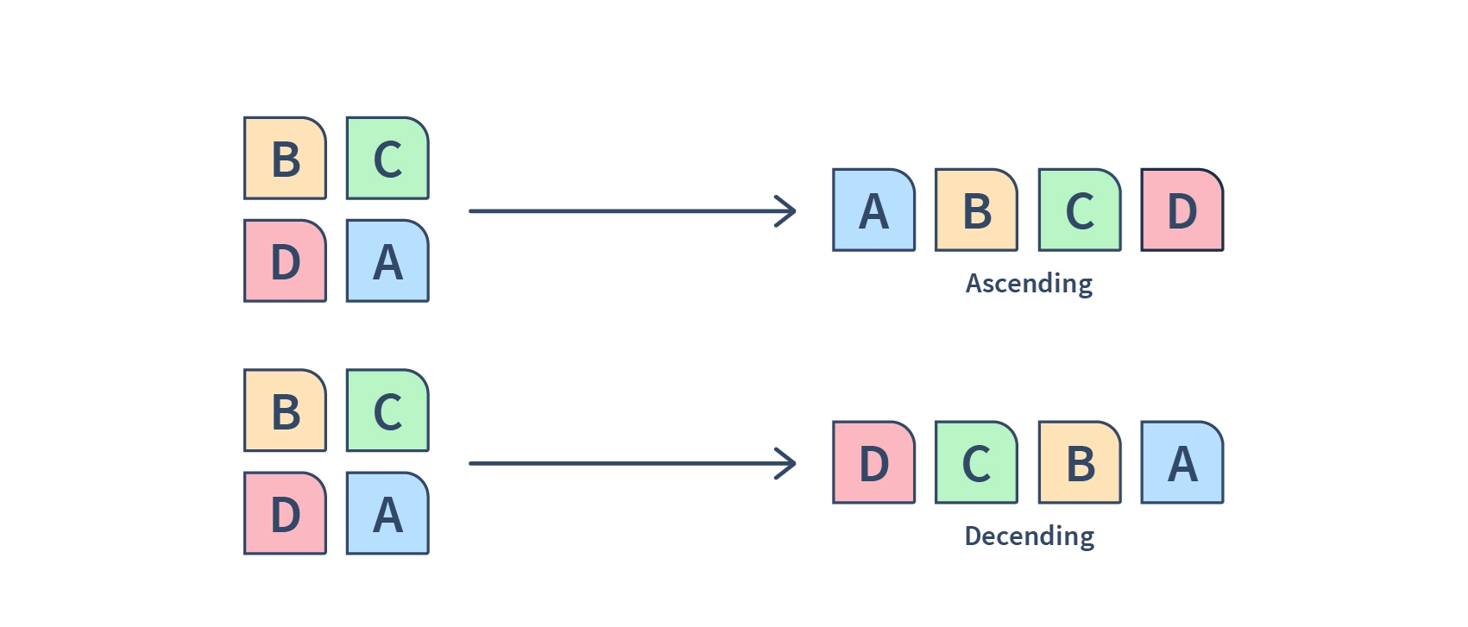
Putting Things in Order
Sorting Algorithms
Introduction: Sorting algorithms arrange data in a specific order (ascending or descending)
.Algorithms for Comparison: Choose two common sorting algorithms (Bubble Sort vs., Insertion Sort).

Slide 20
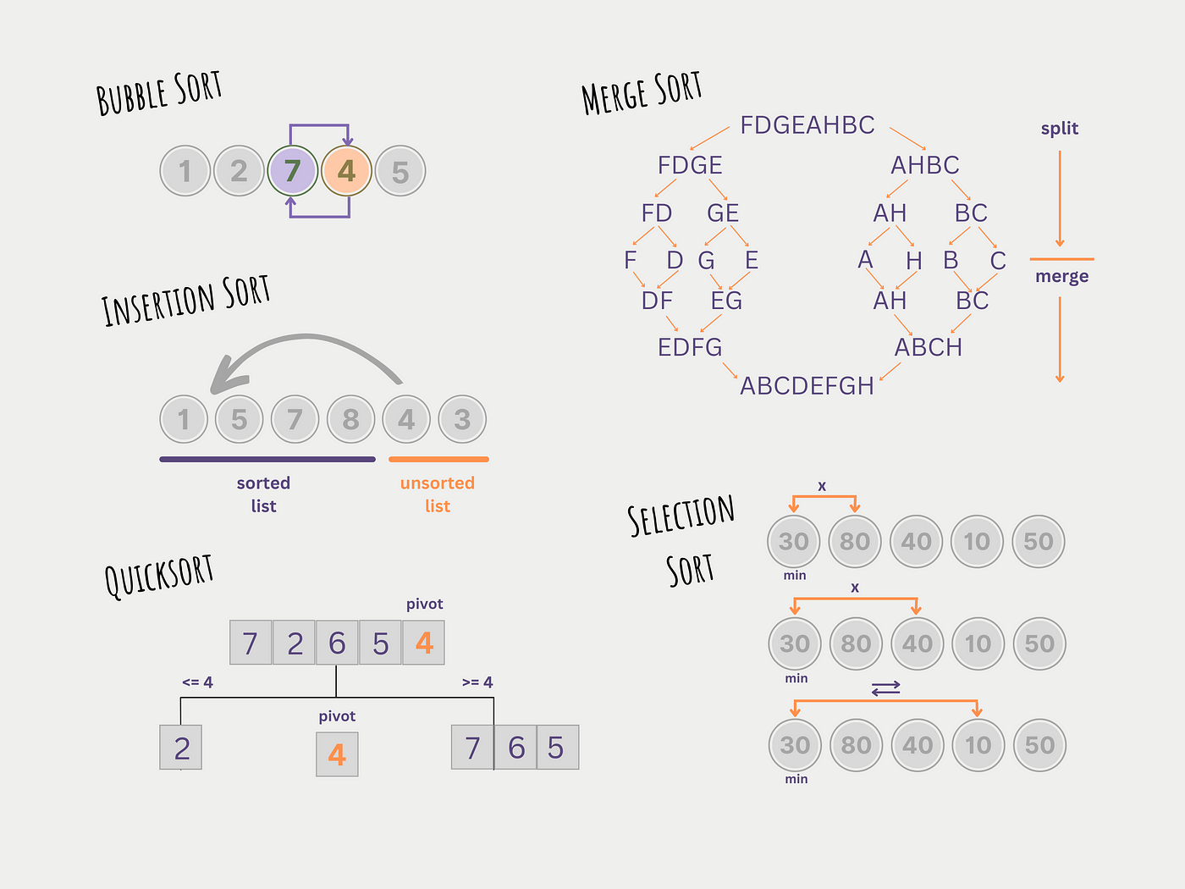
Sorting Algorithms

Slide 21
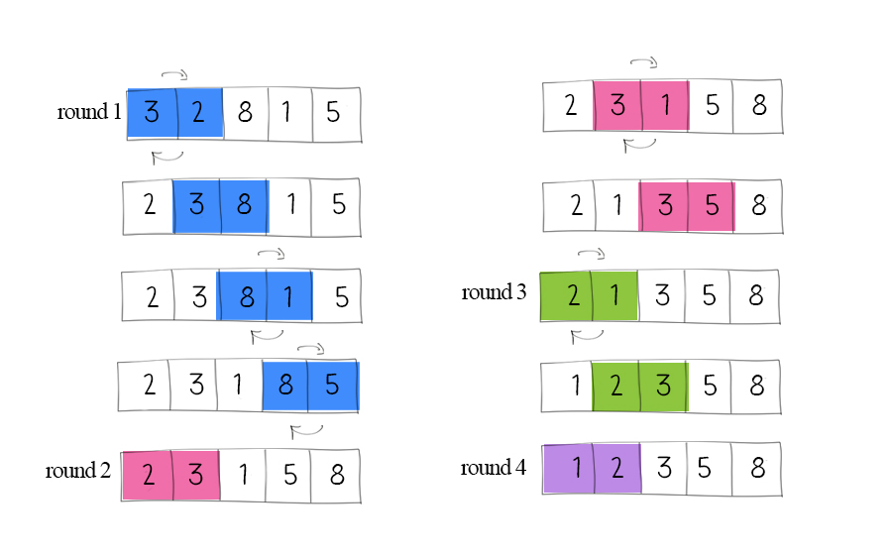
Bubble Sort: A Simple Sorting Approach
Algorithm 1: Bubble Sort
Bubble Sort works by repeatedly stepping through the list, comparing adjacent elements and swapping them if they are in the wrong order.
This process is repeated until no more swaps are needed, indicating that the list is sorted.

Slide 22
Implements in Java
Algorithm 1: Bubble Sort
public void bubbleSort(int[] arr) {
int n = arr.length;
for (int i = 0; i < n-1; i++) {
for (int j = 0; j < n-i-1; j++) {
if (arr[j] > arr[j+1]) {
int temp = arr[j];
arr[j] = arr[j+1];
arr[j+1] = temp;
}
}
}
}

Slide 23
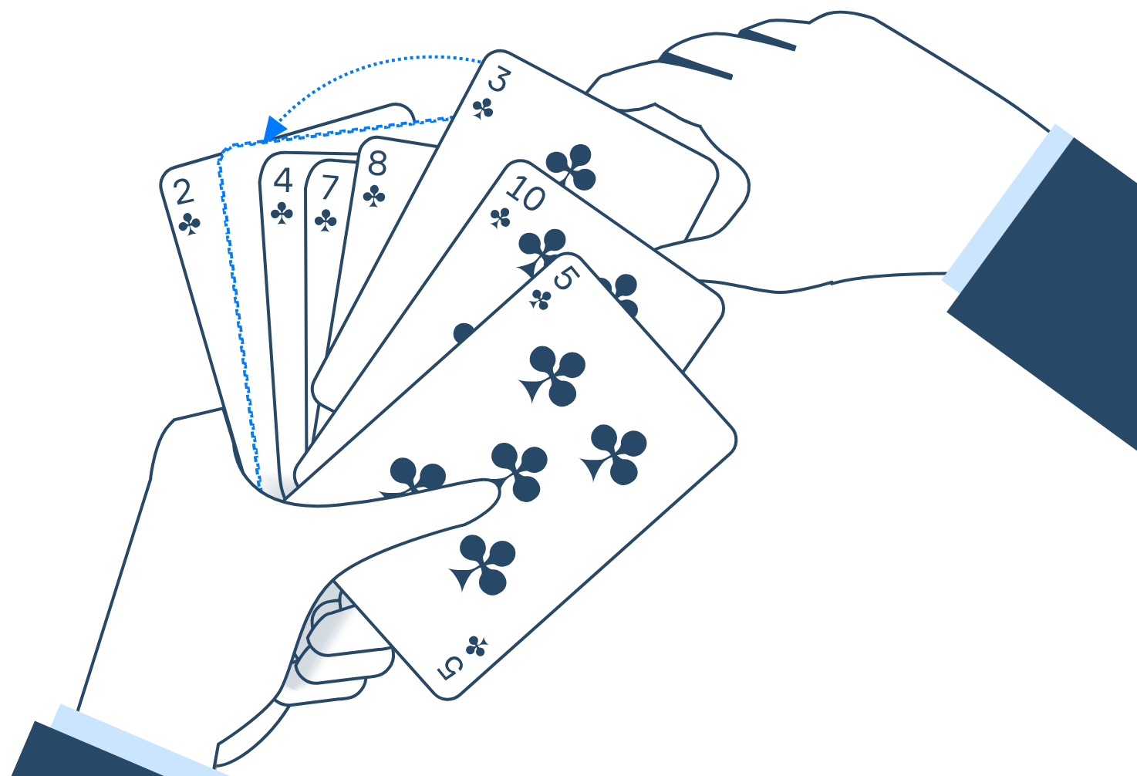
Insertion Sort: Building a Sorted List One Item at a Time
Algorithm 2: Insertion Sort
Insertion Sort builds the final sorted array (or list) one item at a time.
It iterates through the input elements, removing one element from the input data each repetition, and growing a sorted output list.
At each iteration, Insertion Sort removes one element from the input data, finds the location it belongs within the sorted list, and inserts it there.
It repeats until no input elements remain.

Slide 24
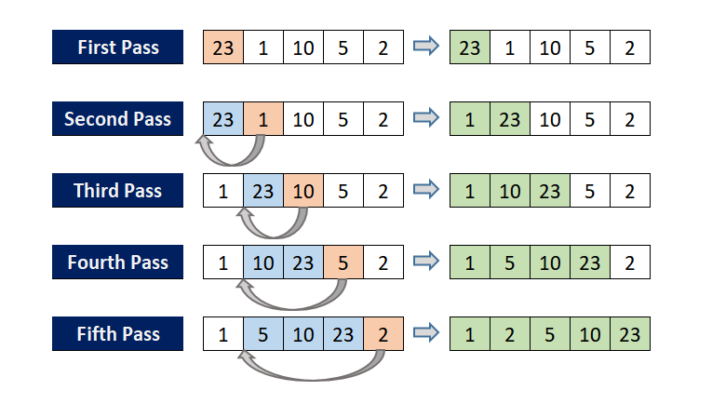
Insertion Sort: Visualization
Algorithm 2: Insertion Sort

Slide 25
Implements in Java
Algorithm 2: Insertion Sort
public void insertionSort(int[] arr) {
int n = arr.length;
for (int i = 1; i < n; ++i) {
int key = arr[i];
int j = i - 1;
while (j >= 0 && arr[j] > key) {
arr[j + 1] = arr[j];
j = j - 1;
}
arr[j + 1] = key;
}
}

Slide 26
Insertion Sort: Visualization
Algorithm 2: Insertion Sort

Slide 27
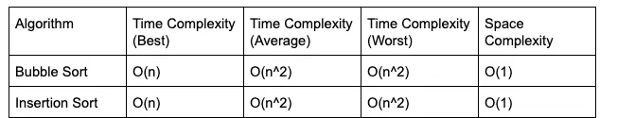
Comparing Bubble and Insertion Sort
Comparison

Slide 28
Network Shortest Path Algorithms

Slide 29
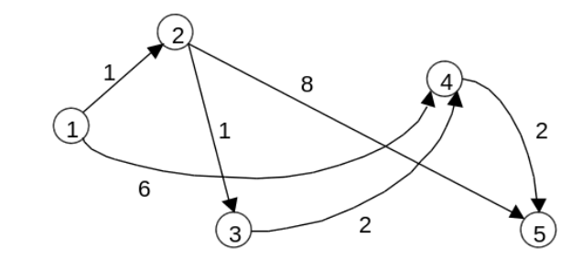
Shortest Path Algorithms
Introduction
In many real-world scenarios, we need to find the shortest path between two points in a network. This is where network shortest path algorithms come in.
Examples: GPS navigation (finding the fastest route), network routing (optimizing data flow), transportation planning (minimizing travel time).

Slide 30
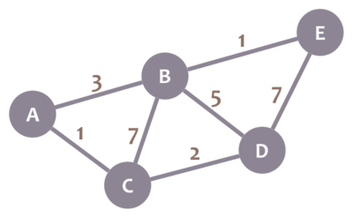
Dijkstra's Algorithm
Dijkstra's Algorithm
Dijkstra's algorithm is a classic and efficient algorithm for finding the shortest paths from a single source node to all other nodes in a weighted graph with non-negative edge weights.
It works by iteratively selecting the unvisited node with the smallest tentative distance and updating the distances of its neighbors.

Slide 31
thank you
Pham Minh van
0394213659
phamvanminh1723@gmail.com

